Slide 1
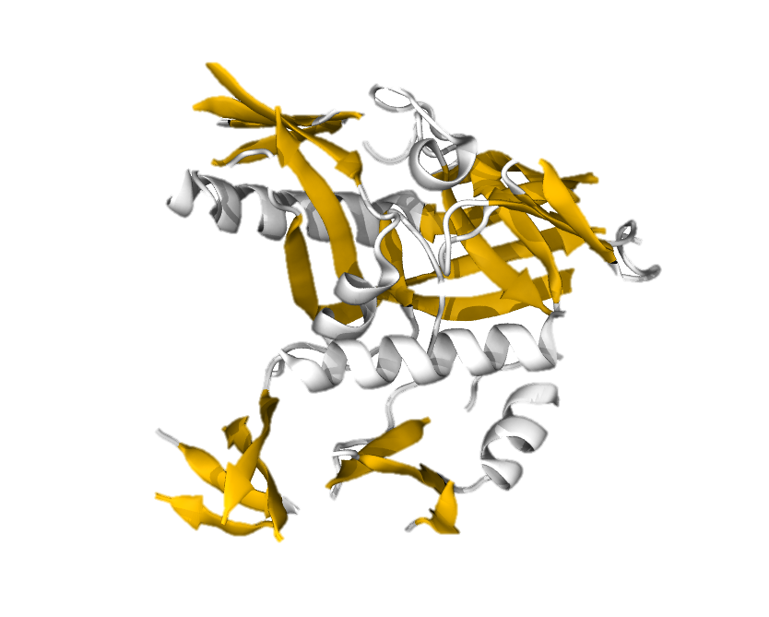
Computational Techniques in Chemistry
Session 3:
Molecular simulation of biomolecular systems
Delivered by Tim Spankie
University of Edinburgh
January 2025
Based on content from a ten-hour series https://github.com/CCPBioSim/BioSim-analysis-workshop
by Matteo Degiacomi (matteo.degiacomi@ed.ac.uk) and Antonia Mey (antonia.mey@ed.ac.uk)

Slide 2
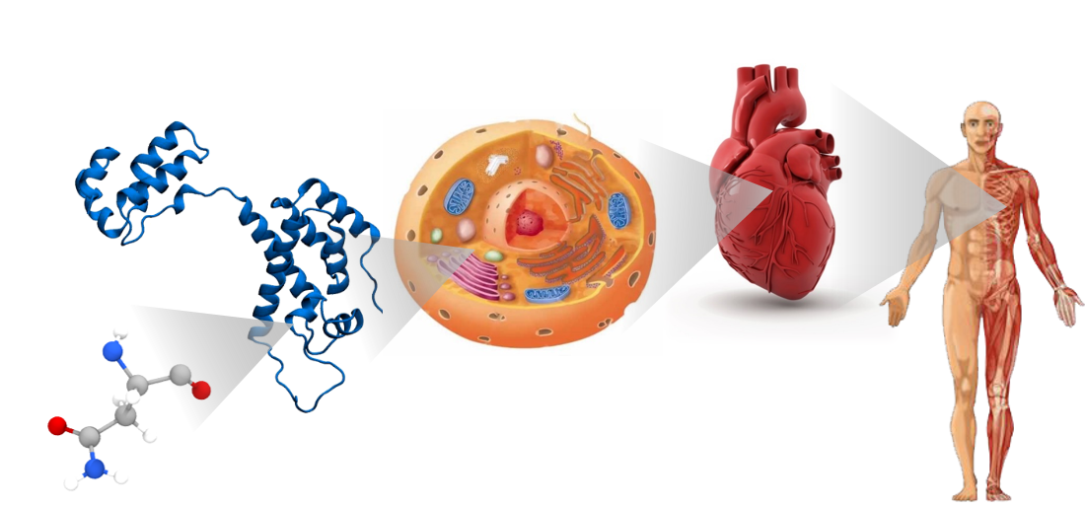
The structure determines the (mal)function

Slide 3
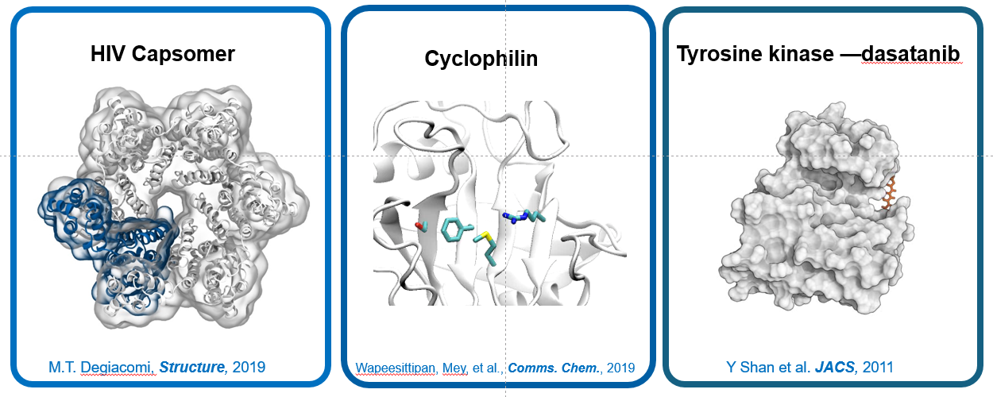
Structure and dynamics determine protein (mal)function
Notes:
HIV capsomer -> assemble as part of a virus hexamer assembly

Slide 4
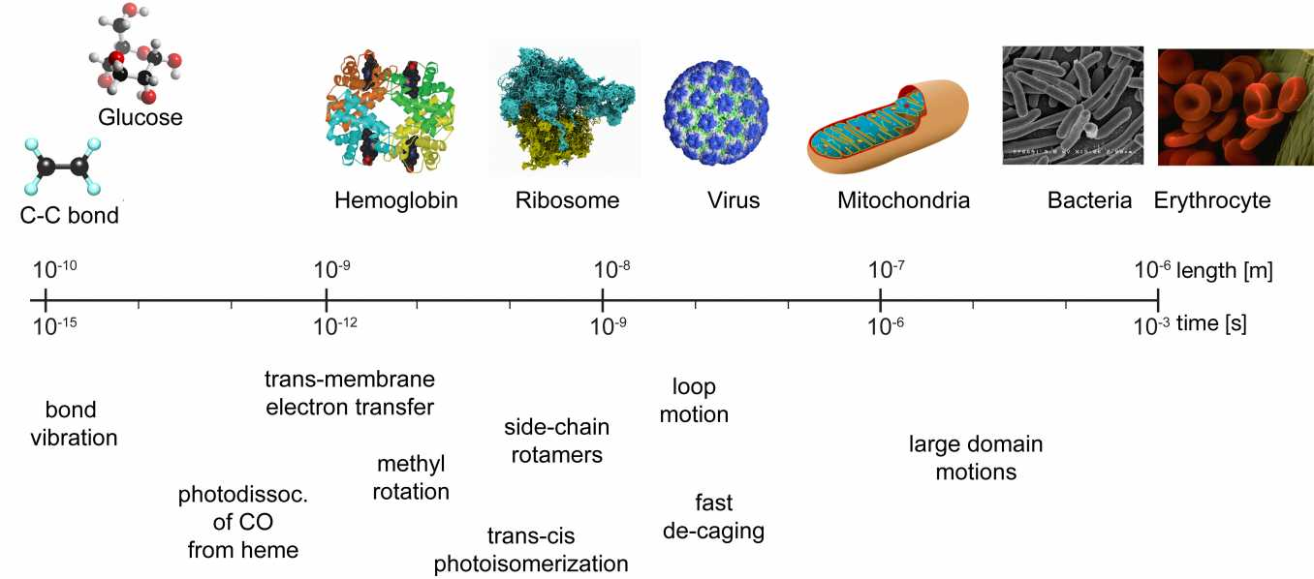
Sizes in Biochemistry
Molecular Dynamics

Slide 5
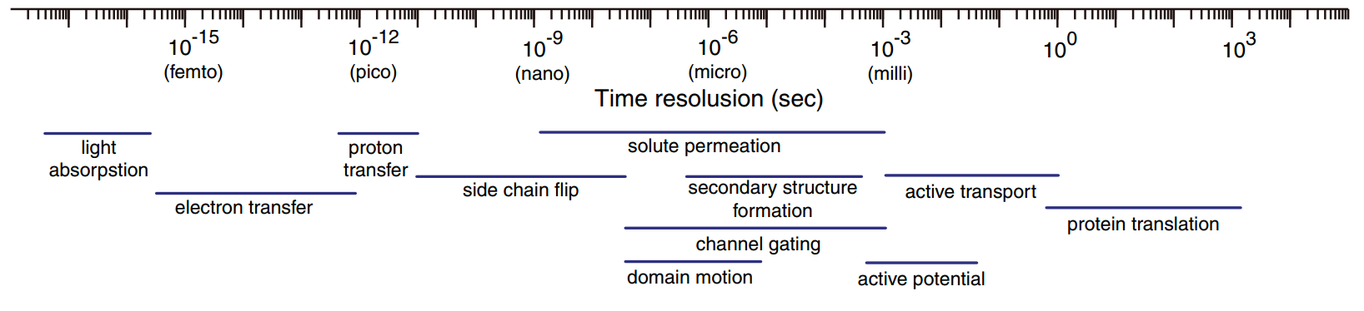
Timescales in biochemistry
Molecular Dynamics
Time resolution (sec)
Light absorption
Proton transfer
Solute permeation
Side chain flip
Secondary structure formation
Active transport
Electron transfer
Channel gating
Domain motion
Active potential

Slide 6
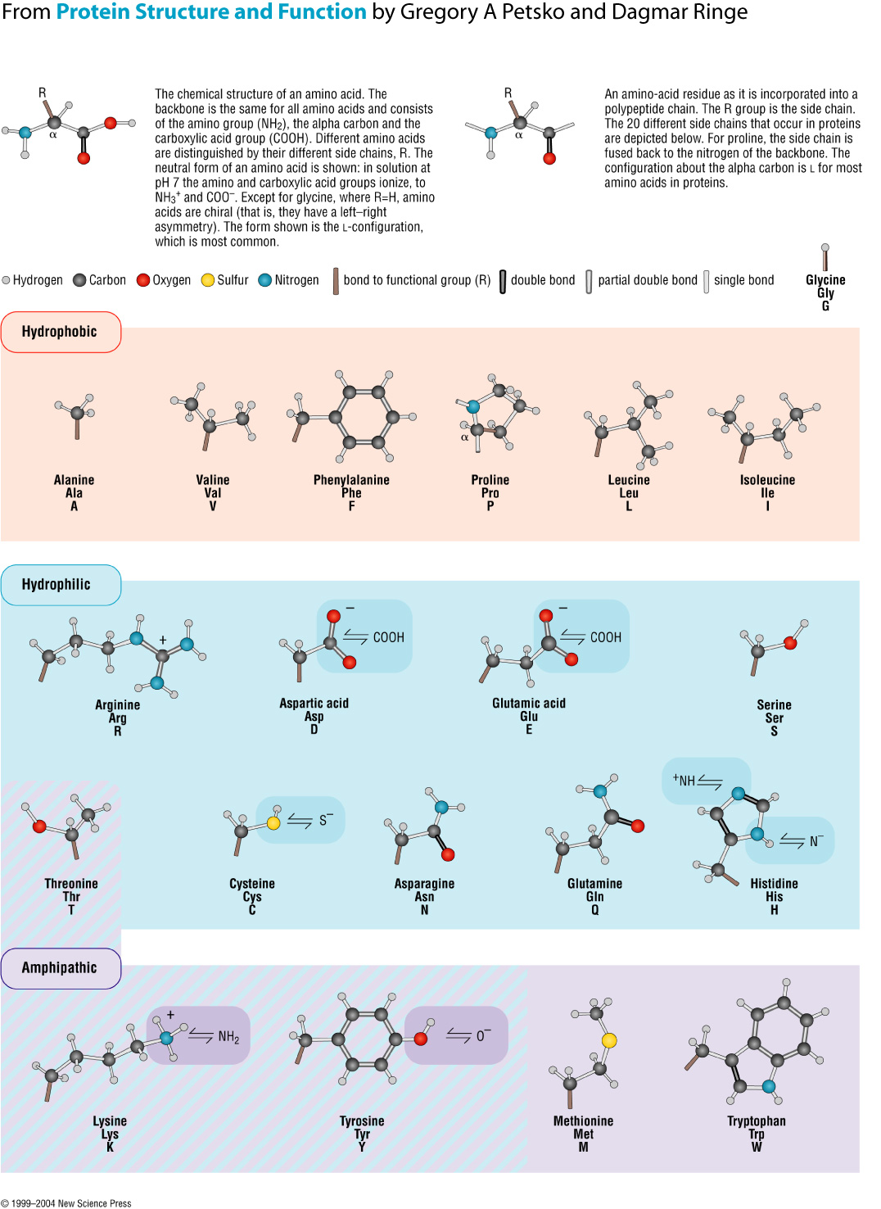
Proteins are amino acids polymers
Amino acids are composed of:
Backbone (conserved)
Side chain (variable)
Side
chain
-
+
α
@neutral pH
Notes:
Polymers made of 20 amino acids
Sorted in whatever order
Conserved backbone and variable side chain

Slide 7
Proteins are amino acids polymers
Amino acids are composed of:
Backbone (conserved)
Side chain (variable)
Side
chain
α
α
Side
chain
Amino acids polymerize forming a peptidic bond (condensation)

Slide 8
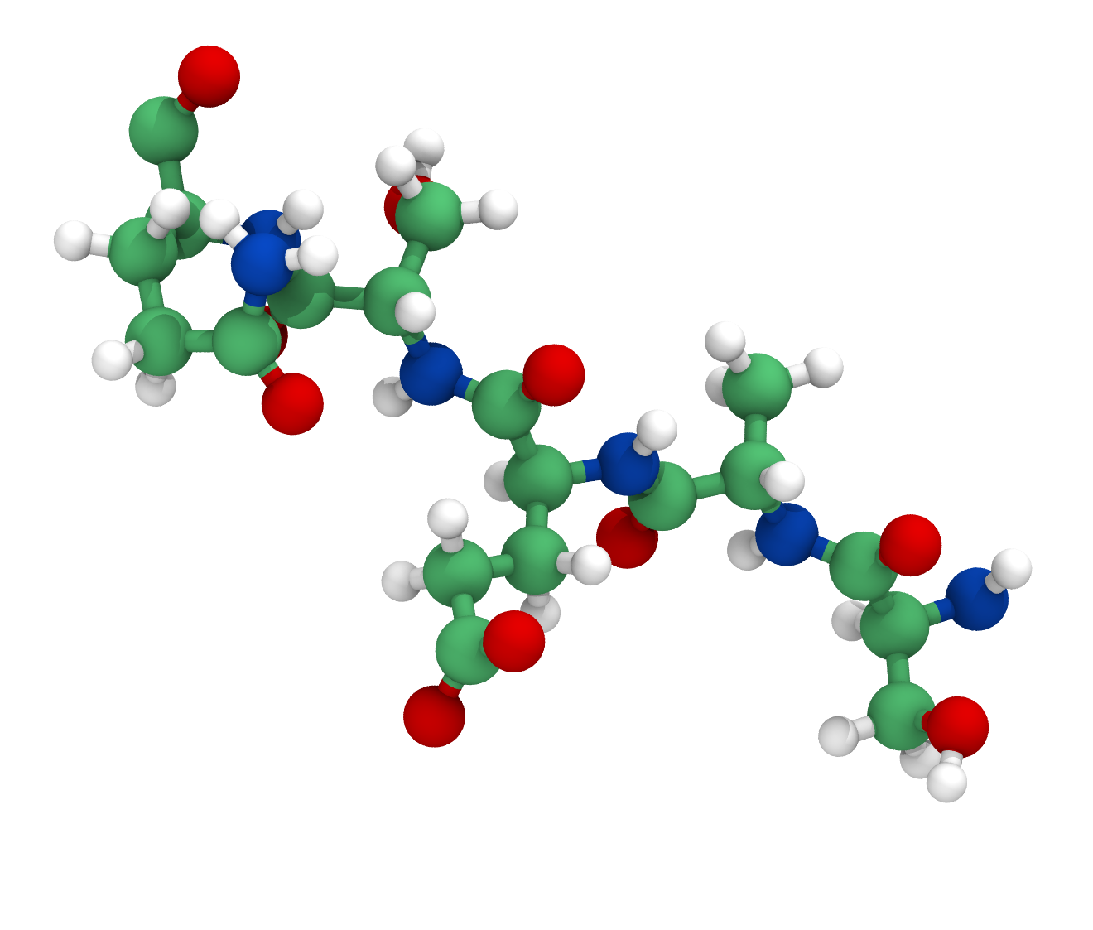
Proteins are amino acids polymers
Amino acids are composed of:
Backbone (conserved)
Side chain (variable)
Glutamic acid
GLU
E
Glutamine
GLN
Q
Serine
SER
S
Side
chain
α
α
Side
chain
Alanine
ALA
A
Serine
SER
S
Amino acids polymerize forming a peptidic bond (condensation)
Notes:
Écrire equation («c’est très simple!»)
Sequences of 3 letter or 1 letter code

Slide 9
Protein Primary Structure: Sequence
SAESQ
Proteins with similar sequence, likely:
have similar functions in an organism
are evolutionarily related
Notes:
Serine alanine glutamic acis serine glutamine
Primary sequence -> most often as a text-> similar sequence often similar sturcutre -> similar function

Slide 10
Protein Secondary Structure
The amino acid chain path is determined by backbone torsional angles

Slide 11
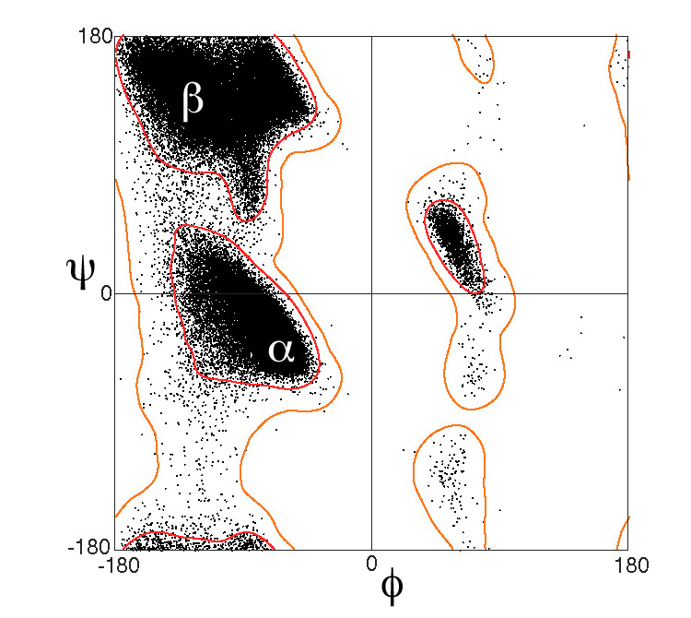
Protein Secondary Structure
The amino acid chain path is determined by backbone torsional angles
Ramachandran plot: scatter plot of amino acids backbone torsional angles
Dictionary of Secondary Structure in Proteins (DSSP) classification defines 7 secondary structure elements (regions in the plot):
H = α-helix
G = 3₁₀ helix
I = π-helix
B = residue in isolated β-bridge
E = extended strand
T = hydrogen bonded turn
S = bend
W. Kabsch and C. Sander, Dictionary of protein secondary structure: Pattern recognition of hydrogen‐bonded and geometrical features, Biopolymers, 1983

Slide 12
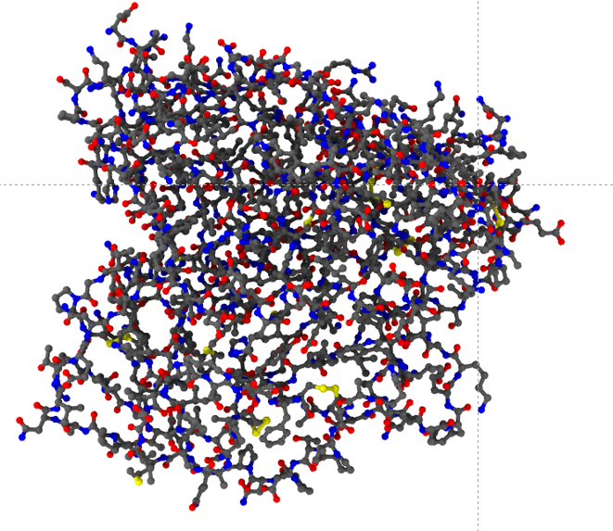
Protein tertiary structure: folding
Protein («polypeptide»): 10 to >1000 amino acids

Slide 13
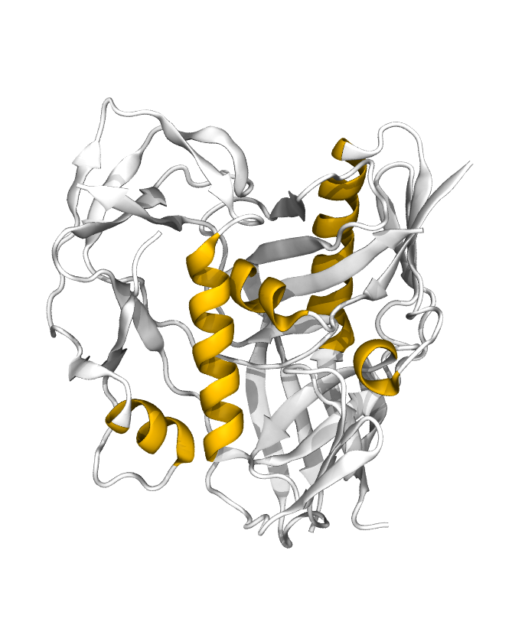
Protein tertiary structure: folding
Protein («polypeptide»): 10 to >1000 amino acids
Cartoon
representation:
helices

Slide 14
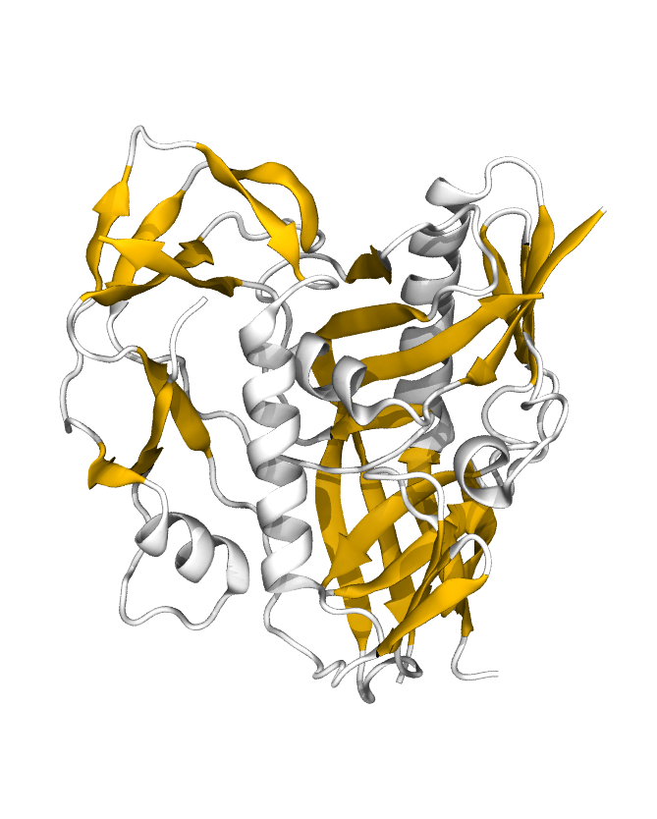
Protein tertiary structure: folding
Protein («polypeptide»): 10 to >1000 amino acids
Cartoon
representation:
sheets

Slide 15
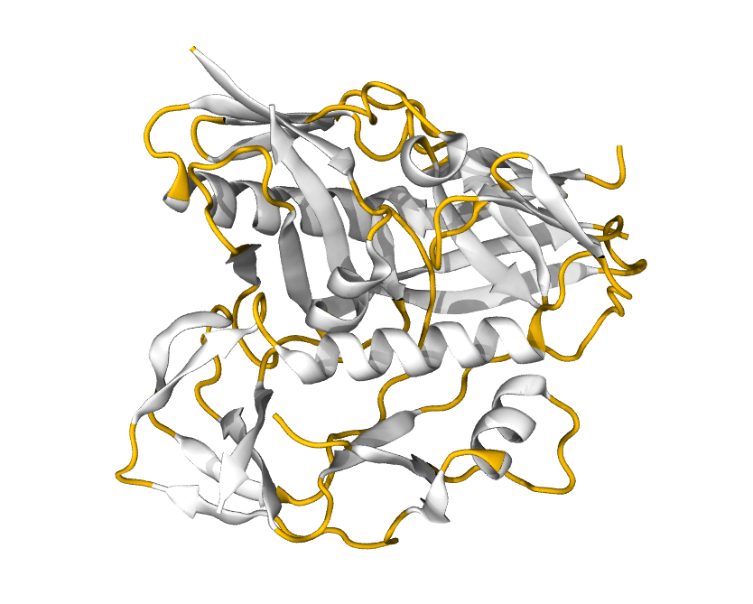
Protein tertiary structure: folding
Protein («polypeptide»): 10 to >1000 amino acids
Cartoon
representation:
loops

Slide 16
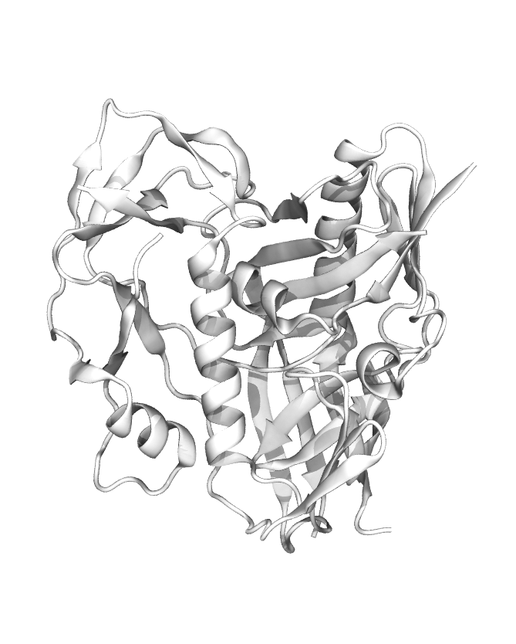
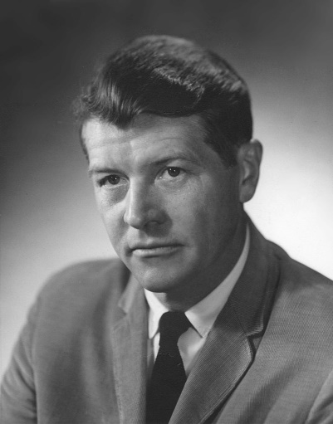
Protein tertiary structure: folding
Protein («polypeptide»): 10 to >1000 amino acids
Anfinsen’s dogma
The three-dimensional structure of a protein in its native environment is solely determined by its amino acid sequence.
Christian Anfinsen. Principles that govern the folding of protein chains, Science, 1973
Notes:
Nobel in 1972

Slide 17
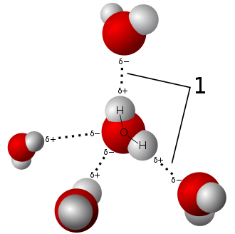
Hydrogen bonds
Electrostatic interaction. Structure:
donor-acceptor distance typically 1.6-2 Å
donor-acceptor-hydrogen angle must be small
Hydrogen bond energy in biomolecular systems typically 5-25 kJ/mol, e.g.:
O−H···:O , 21 kJ/mol (5.0 kcal/mol)
N−H···:O , 8 kJ/mol (1.9 kcal/mol)
amino acids’ backbone and polar side chains can be donor/acceptor
Notes:
Hydrogen bonds are an electrostatic force.
Oxygen slight positive and slight negative charge on oxygen and hydrogen
Water coordiantes in tetrhedral fashion because of the partial charges
Is it partial charges only or dipole interactions
H-bonds are quite week.

Slide 18
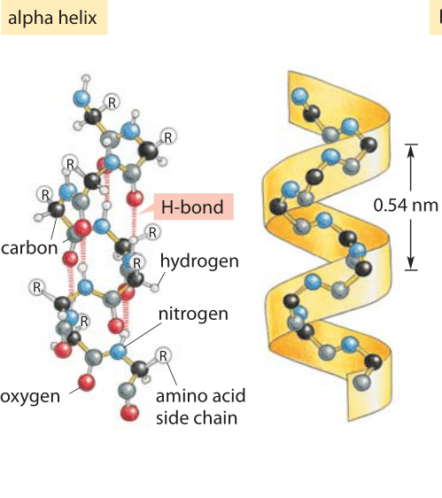
Hydrogen bonding on protein backbone
book.bionumbers.org
Notes:
Emergent property to stabalise secodnary structure in proteins

Slide 19
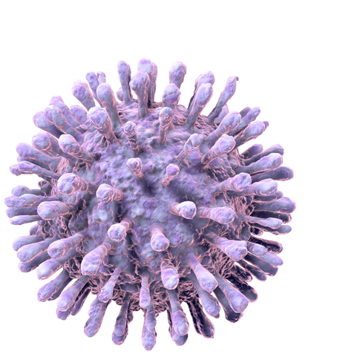
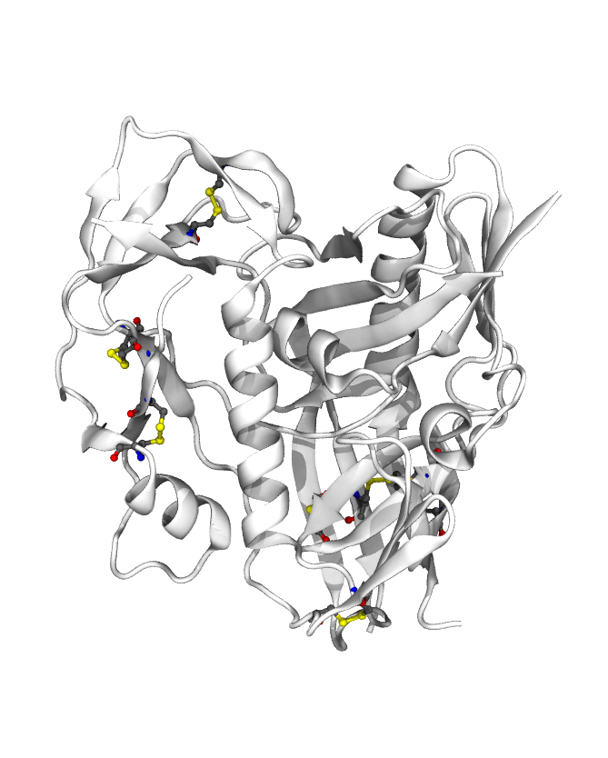
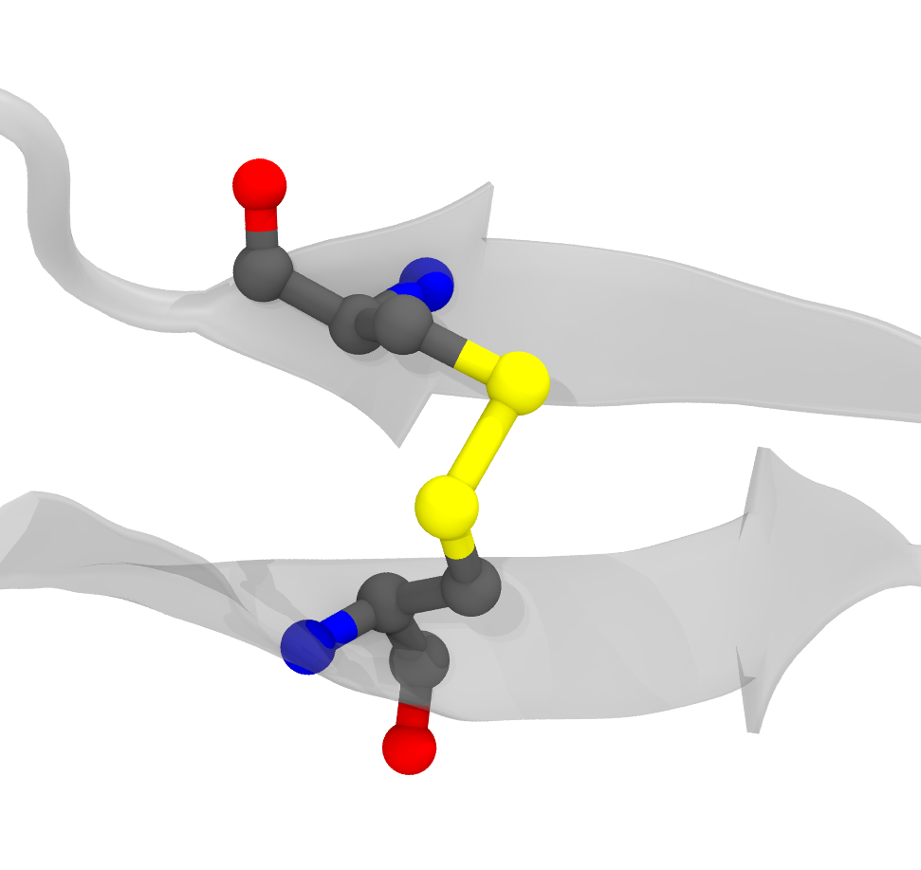
Disulfide bridges
Under oxidising conditions, cysteine side chains can form a covalent bond.
Protein more resistent to denaturation
Changes in conditions structural change
HIV-1 virus
gp120, PDB: 5F4L
T.J.Bechtel and E.Weerapana, From structure to redox: the diverse functional roles of disulfides and implications in disease, Proteomics, 2017
Notes:
NEGATIVE deltaH = exothermic (energy is released). Bond formation is exothermic.
Spike of the HIV-1 virus.
Disulphies can be used as sensors of environments
Top of antenna of virus
Membranes are oxidising
Leads to disulphides to break
Initiates signal cascade telling virus we are close to a target cell.
Keratin (in hair) contains 14% cysteine. When you burn hair, you smell sulfur.
HIV-1 gp120, interaction with thioredoxin leads to conformational change promoting virus inserion
Oxydation: loss of an electron (increase in oxydation state)
Reduction: gain of eletron (decrease in oxydation state)
In eucaryots, endoplasmic reticulum (where proteins fold) is an oxydising environment, while cytoplasm is reducing

Slide 20
Proteins, illness, and drug design
Proteins in diseases (e.g., COVID-19, salmonella, flu, ...)
pathogen’s own metabolism/structure
pathogen’s weapon
Proteins in disorders (e.g., Cancer, Alzheimer’s, ...)
own protein misfolds
own protein folds, but has different dynamics
Drug
Small molecule designed to specifically bind to a protein, so as to affect its function

Slide 21
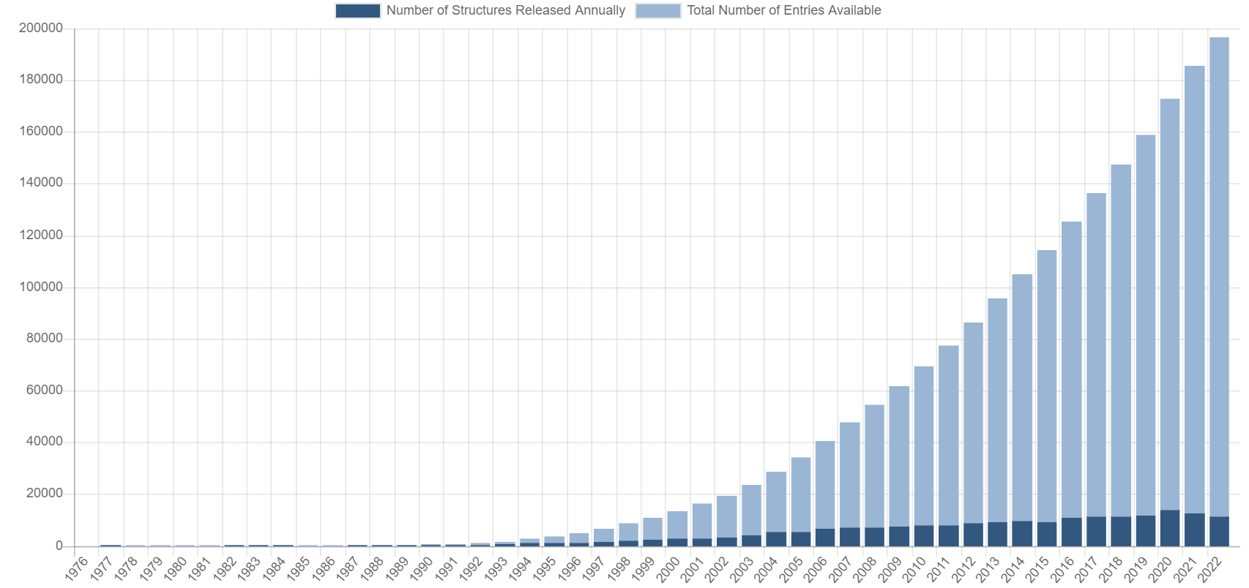
The Protein Data Bank (PDB)

Slide 22
The Protein Data Bank (PDB)
known protein structures: ~80’000 (PDB, 90% identity)
known protein sequences: ~190’000’000 (UNIPROT)

Slide 23
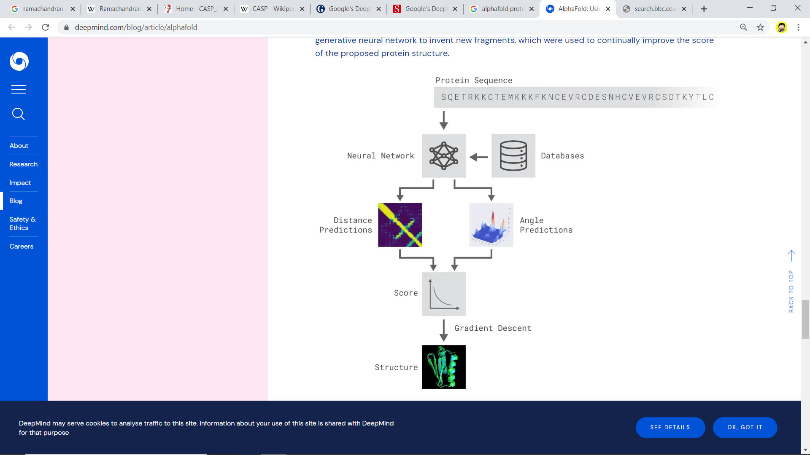
Protein fold prediction
CASP, since 1994 biennial competition on protein fold prediction: predictioncenter.org
prediction

Slide 24
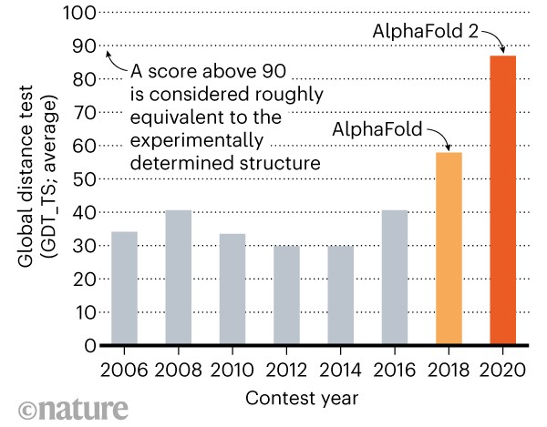
Protein fold prediction
prediction
A.W. Senior et al., Improved protein structure prediction using potentials from deep learning, Nature, 2020
J. Jumper et al., Highly accurate structure prediction with AlphaFold, Nature, 2021
E. Callaway, ‘It will change everything’: DeepMind’s AI makes gigantic leap in solving protein structures, Nature, 2021
Notes:
NEW RESULTS TO BE ADDED

Slide 25
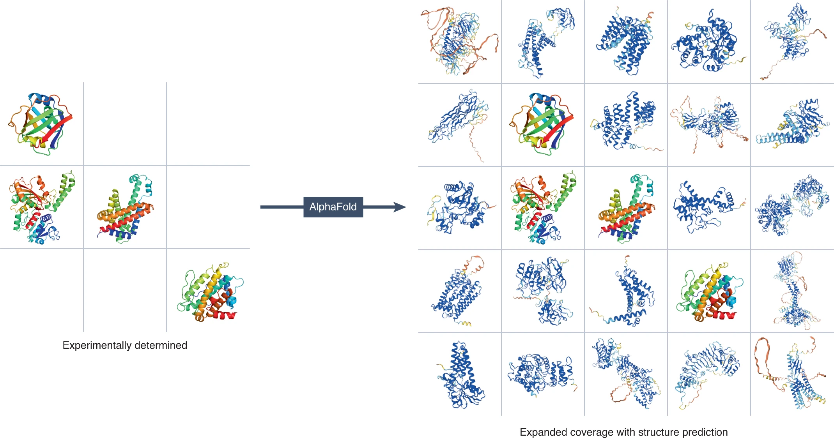
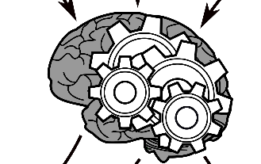
Protein fold prediction: AlphaFold
training
HTIWKLSRLWSLQ…
NITPLAKRTYNYRAVL…
ALRIKAIVVPRILGPQ…
LIYRICMPGILCYEND…

Slide 26
Protein fold prediction: AlphaFold
prediction
MAPVYEGMAS…
HVQVFSPHTL…
QSSAFCSVKK…
LKIEPSSNWD…
MTGYGSHSKV…
…
…

Slide 27
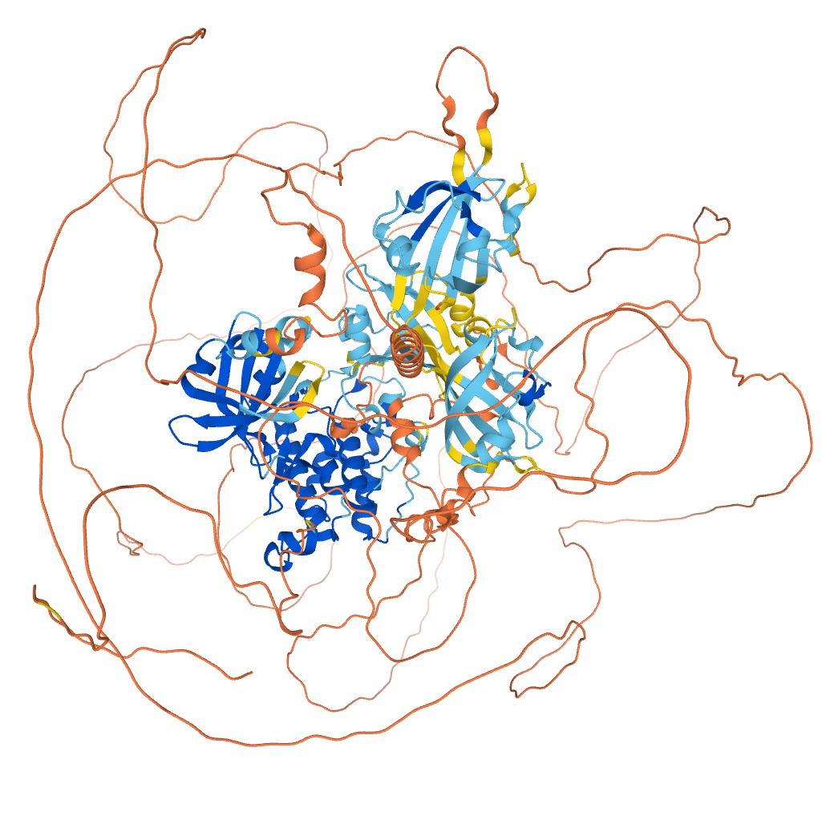
Protein fold prediction: AlphaFold
prediction
YSQSKNIPLS…
PLDDT score: confidence score (100 = high, <50 = low)
Warning: even high-confidence models can be incorrect.

Slide 28
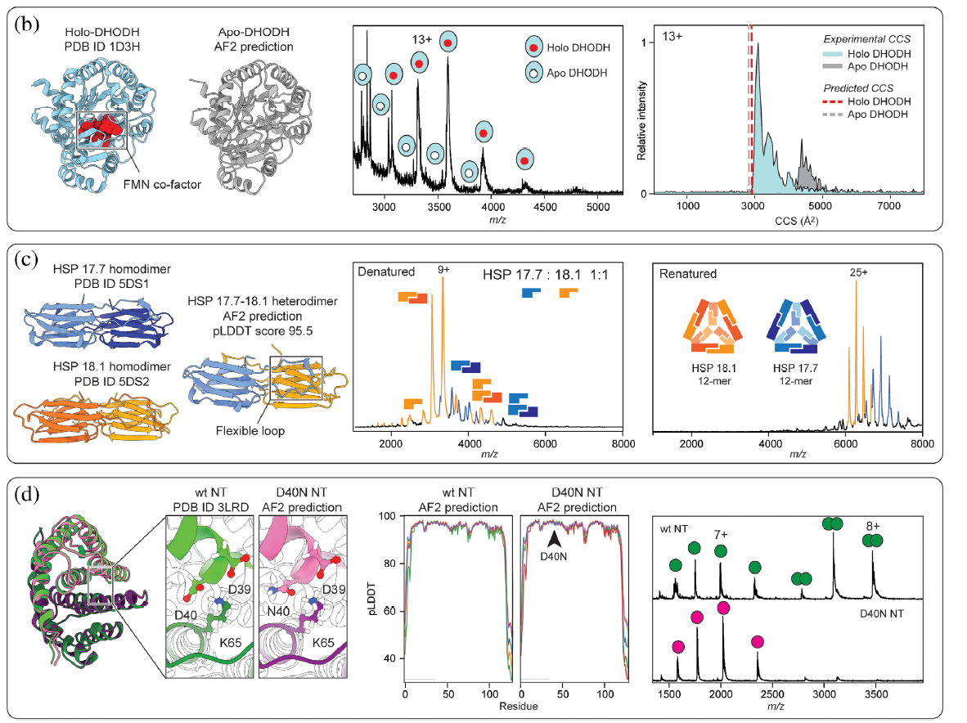
Protein fold prediction: warning!
Apo protein predicted folded like holo state, but it should be unfolded
High-confidence hetero multimer predicted, but proteins do not co-assemble
High-confidence homodimer of mutated protein predicted, but mutation abolishes complex formation
T.M.Allison et al., Protein Science, 2022

Slide 29
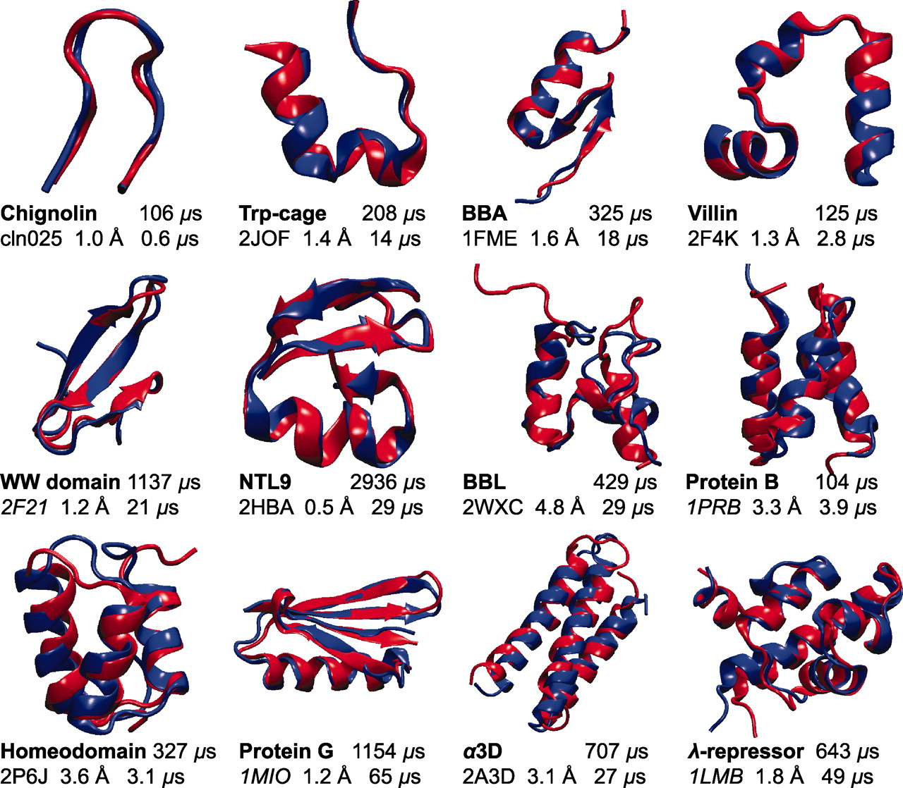
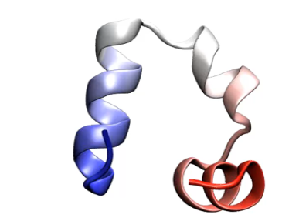
Watching proteins fold: simulation
Following experimentally the folding pathway of a protein is difficult
Folding of small fast-folding (<100 μs) proteins can be studied via simulation
P. Freddolino and K. Schulten. Common structural transitions in explicit-solvent simulations of villin headpiece folding, Biophysical J., 2009
K. Lindorff-Larsen et al. How fast-folding proteins fold, Science, 2011

Slide 30
Next: how to prepare a protein structure so that it is ready for molecular modelling?

Slide 31
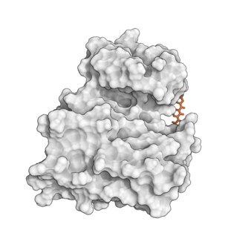
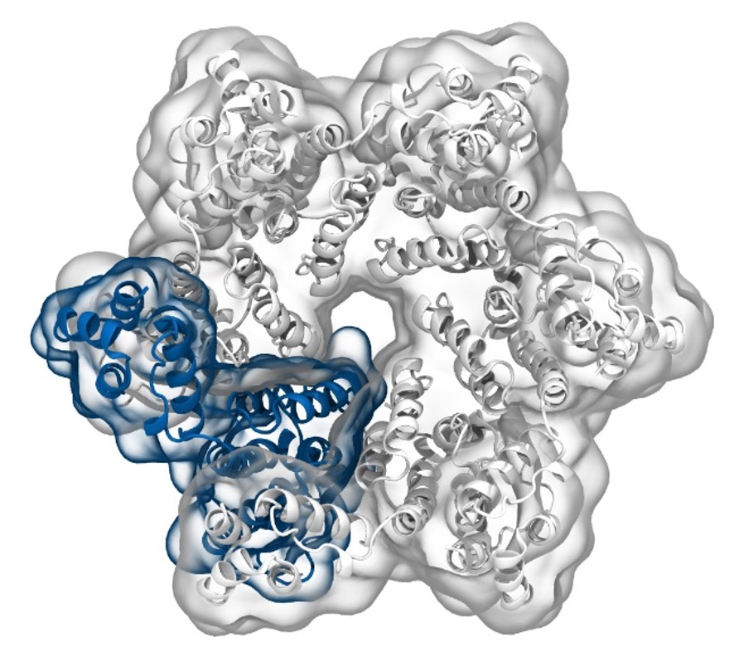
Simulation of Biomolecules
Protein preparation
Delivered by Tim Spankie
University of Edinburgh
January 2025
Based on content from a ten-hour series https://github.com/CCPBioSim/BioSim-analysis-workshop
by Matteo Degiacomi (matteo.degiacomi@ed.ac.uk) and Antonia Mey (antonia.mey@ed.ac.uk)

Slide 32


A typical workflow for molecular dynamics
Get protein structure
pdb api
pdb2gmx
GUI, TCL, bash, Python, Perl … get creative
RDkit
OpenMM tools
Prep for simulation
Amber tools
[…]
Simulation setup
Gromacs
OpenMM
mostly C++
command line
Amber
NAMD
DLPoly
SOMD
Charmm
Run Simulation Protocol
BioSimSpace
Python API
[…]
MDAnalysis
GUI, TCL, bash, Python, Perl, … get creative
PyEMMA
md-analysis-tools
Simulation Analysis
MDTraj
VMD
[…]

Slide 33
Let’s get started with understanding protein structures
Get protein structure
pdb2gmx
Prep for simulation
pdb api
RDkit
OpenMM tools
Simulation setup
Amber tools
Run Simulation Protocol
[…]
GUI, TCL, bash, python, Perl, … get creative
Simulation Analysis

Slide 34
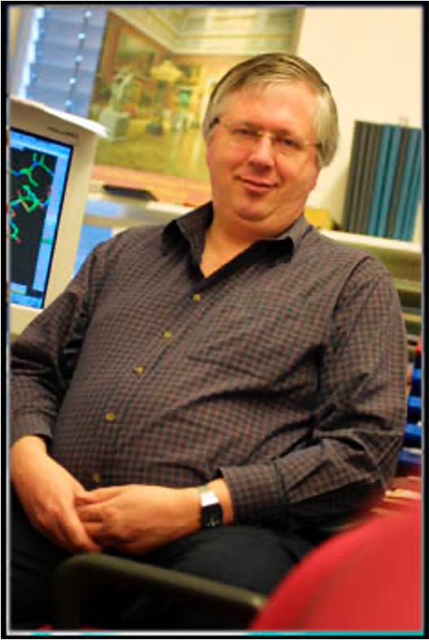
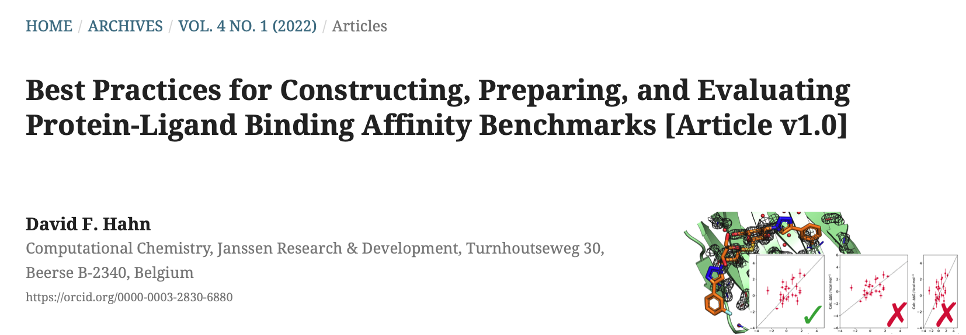
Crystal structures are models with potential errors
Examples of errors/oddities in PDB structures:
https://swift.cmbi.umcn.nl/teach/pdbad/
Gert Vriend (author of WHAT_CHECK)

Slide 35
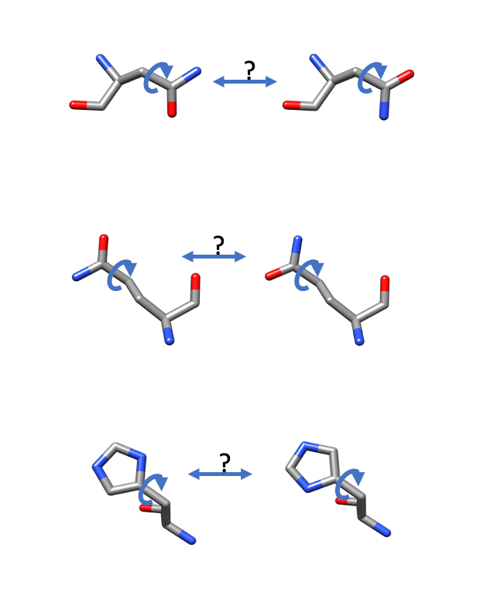
Alternative conformations of side chains - NGH flips
Typically, the crystallographers will have assigned the orientation based on potential H-bonding interactions, etc.
No standard protocol for this: always worth double-checking.
Asparagine (N)
Glutamine (Q)
Histidine (H)

Slide 36
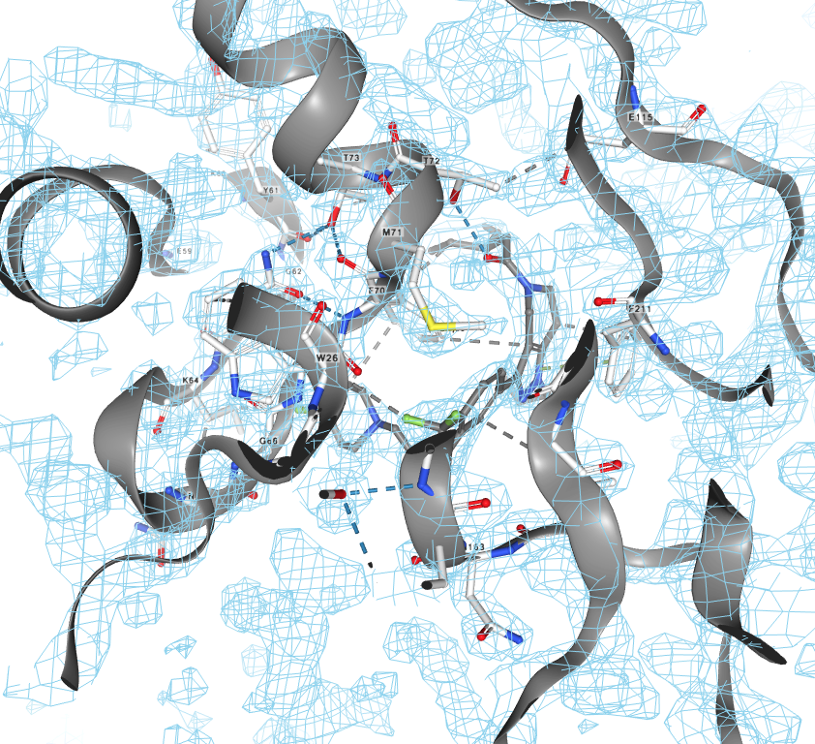
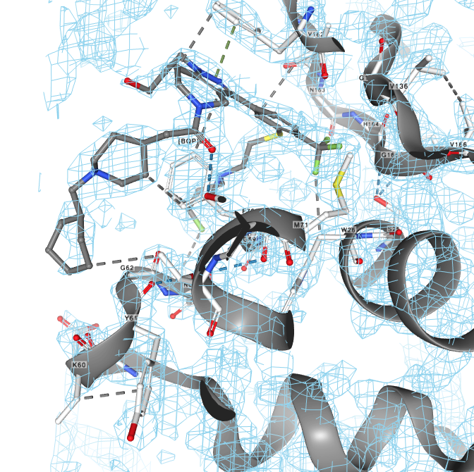
Ligand densities can also have creative input from the crystallographer
Cathepsin S
Cathepsin S with ligand
boat/chair?

Slide 37
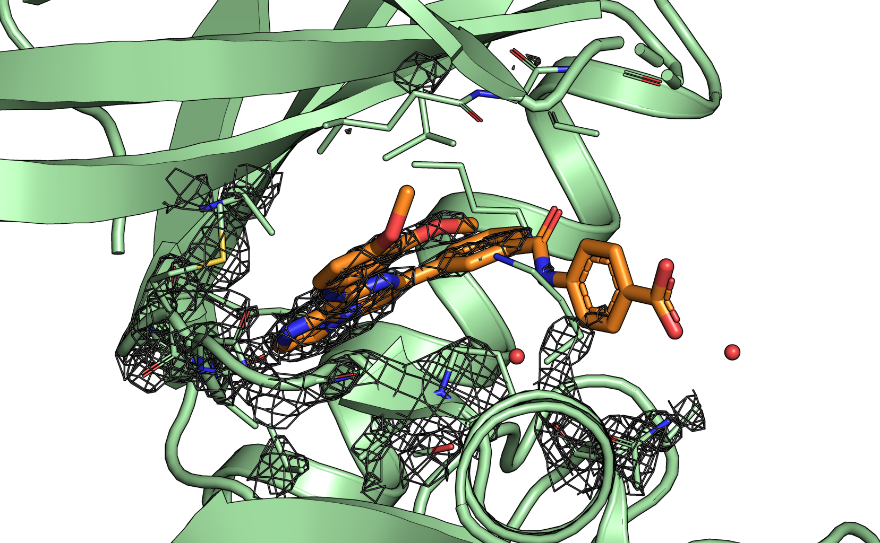
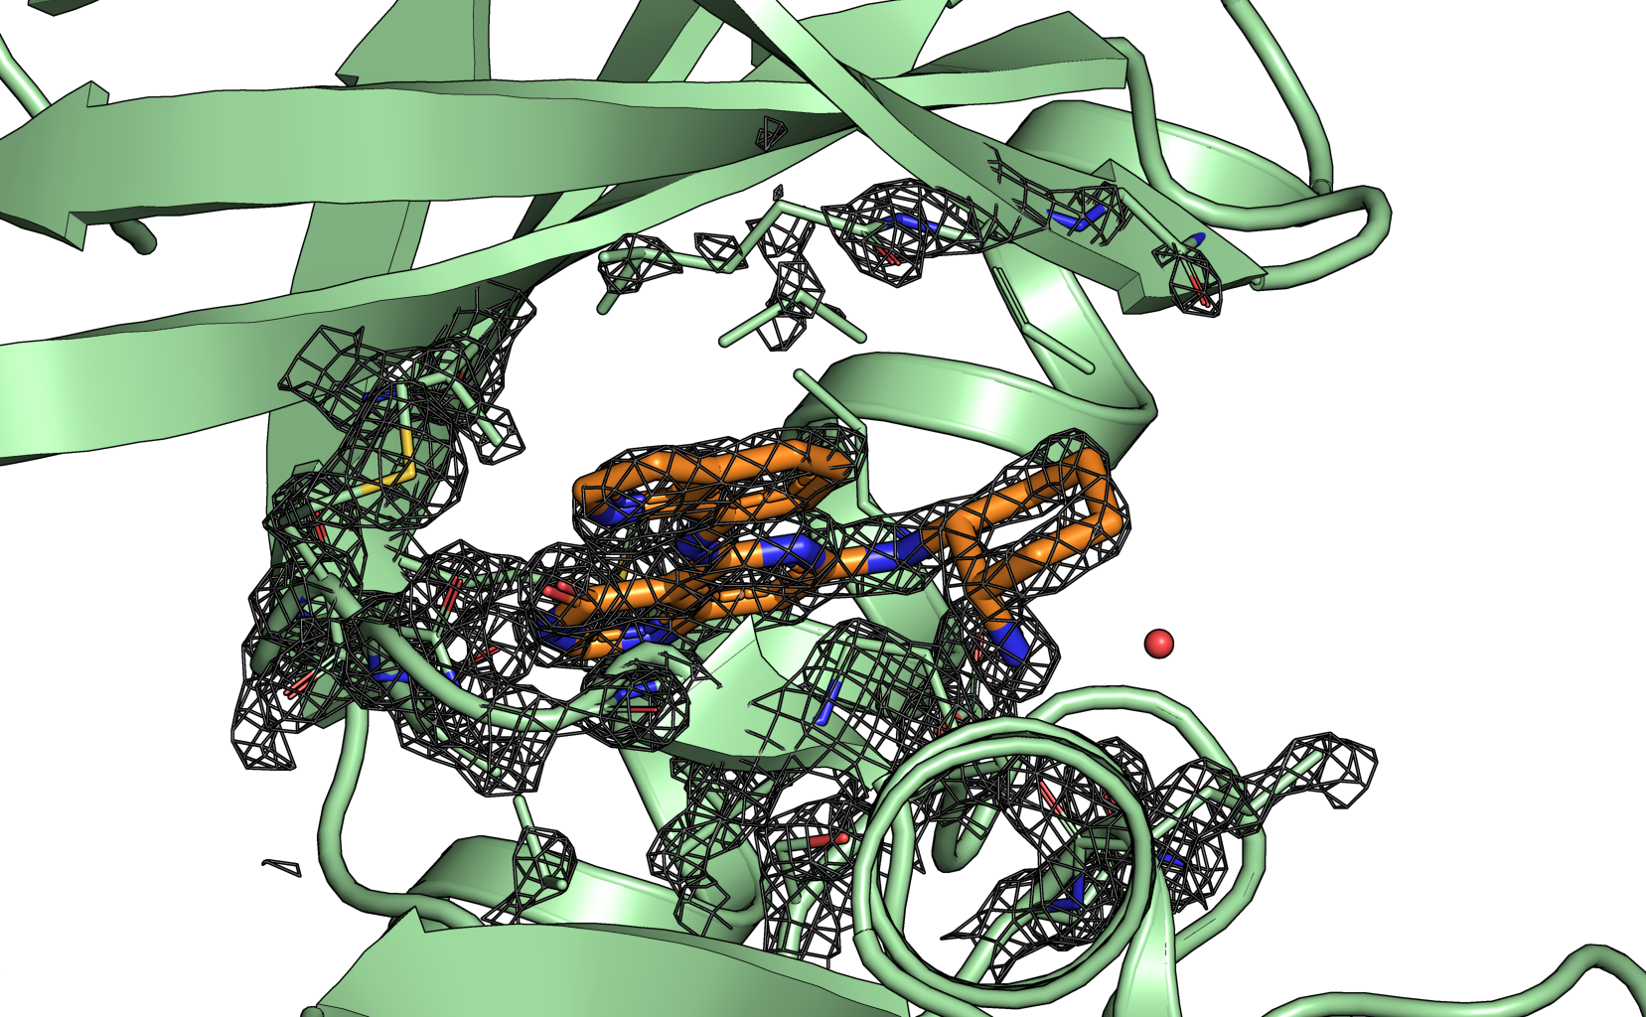
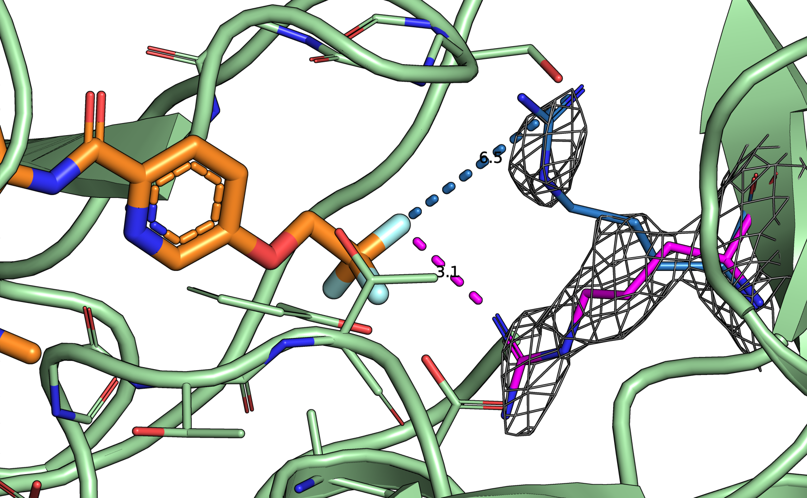
Picking the best crystal structure requires care
spleen tyrosine kinase
BACE (Hunt)
Which protein structure?
Alternative side chain conformations need to be assessed carefully
Active site residue densities are important for choosing the right crystal structure

Slide 38
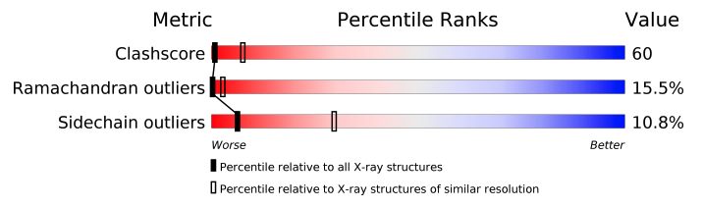
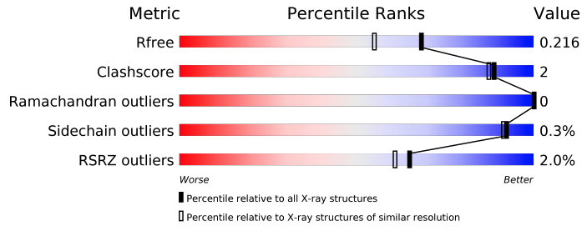
The RCSB PDB report can help with choosing structures
Jnk1 - 2GMX
Jnk1 - 3ELJ

Slide 39
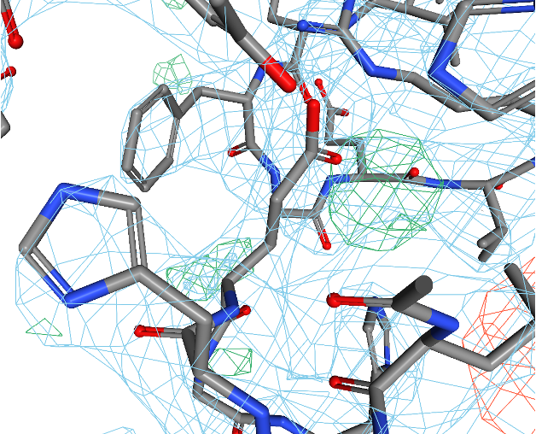
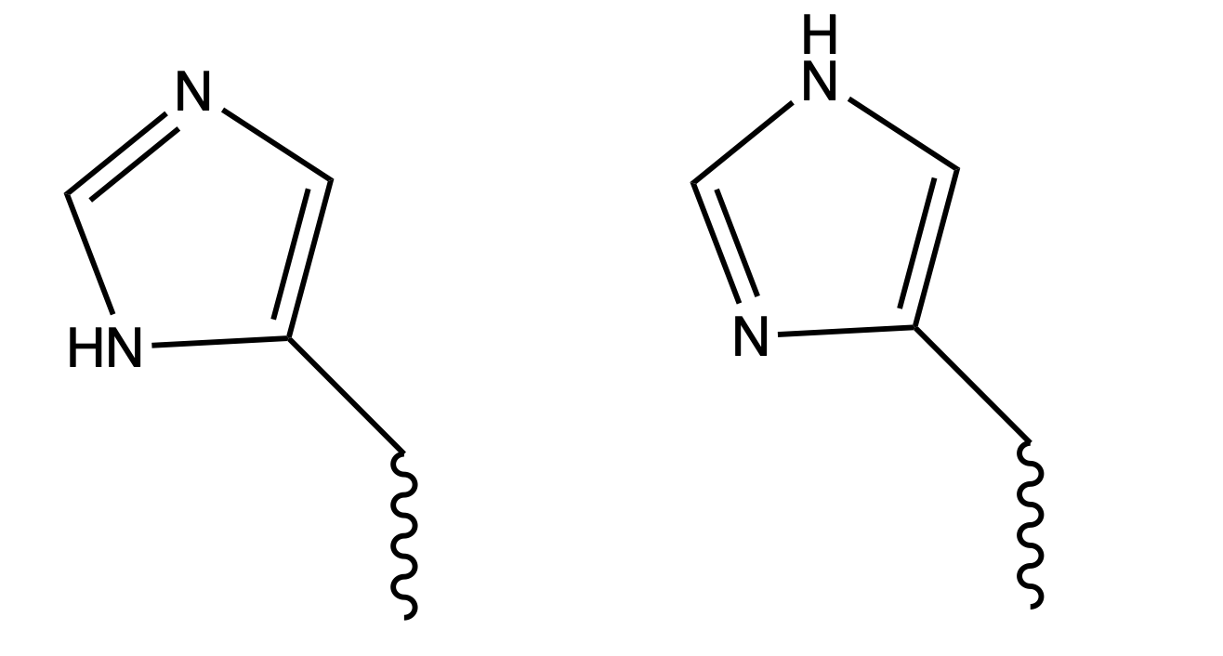
How to choose the right tautomer?
Which tautomer?
His 171
δ-tautomer
ε-tautomer

Slide 40
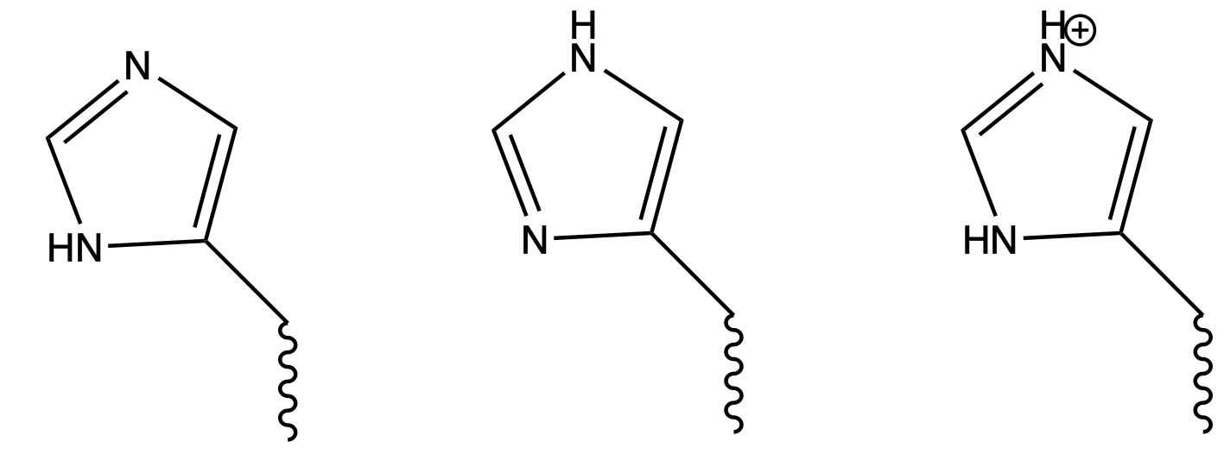
How to choose the right tautomer and protonation state?
Which tautomer and protonation?
His 171
δ-tautomer
ε-tautomer
protonated

Slide 41
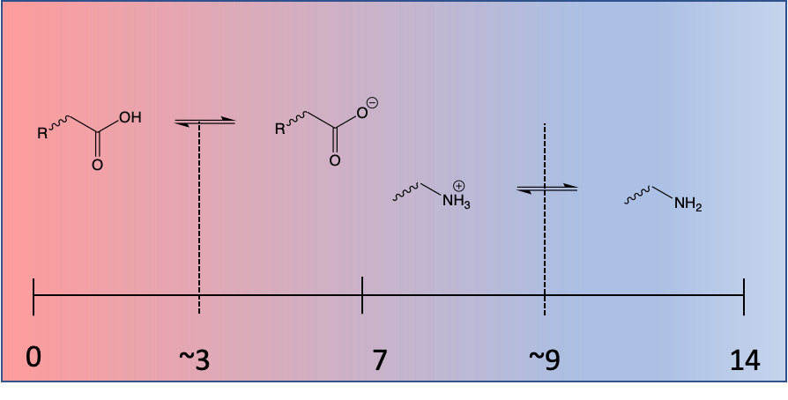
We need to worry about pKa to decide protonation
pKa: pH at which an acidic/basic group is 50% protonated/deprotonated.
pKas are not fixed things!
“Standard” values refer to the situation when the group is in dilute aqueous solution.
Groups buried in the centre of hydrophobic proteins or close to other charged groups can show large pKa shifts.

Slide 42
We need to worry about pKa to decide protonation
Finding the right protonation state for proteins and ligands can be challenging!
Poorly chosen protonation states
can lead to inaccurate simulations by (de)stabilising interactions
can lead to incorrectly estimating binding affinities or protein local or collective dynamics.

Slide 43
Amino acids that need protonation state consideration
Amino acid | pKa | options | Significance*
Aspartic acid | 3.65 | –COOH instead of COO⁻? | possible
Glutamic acid | 4.25 | –COOH instead of COO⁻? | possible
Histidine | 6.00 | protonated instead of neutral? | very possible
Cysteine | 8.18 | –S⁻ instead of SH? | very possible
Tyrosine | 10.07 | –O⁻ instead of OH? | possible
Lysine | 10.53 | –NH2 instead of NH3⁺? | possible
Arginine | 12.48 | neutral instead of protonated? | unlikely
* for a simulation around physiological pH

Slide 44
Simulation of Biomolecules
Setting up a protein
simulation
Delivered by Tim Spankie
University of Edinburgh
January 2025
Based on content from a ten-hour series
by Matteo Degiacomi (matteo.degiacomi@ed.ac.uk) and Antonia Mey (antonia.mey@ed.ac.uk)

Slide 45
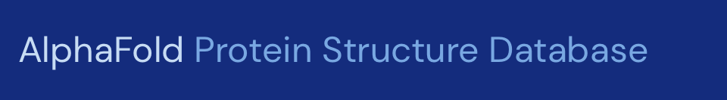

A typical workflow for molecular dynamics
Get protein structure
Getting your protein structure
Prep for simulation
Simulation setup
Getting ligands/co-factors
Run Simulation Protocol
Simulation Analysis

Slide 46
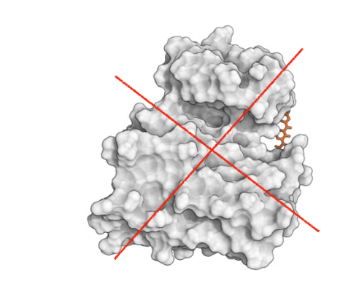
Disclaimer!
Running biomolecular MD can take days on specialised hardware.
Today we will not run any of them, and instead will focus on fundamental principles using small molecules.

Slide 47
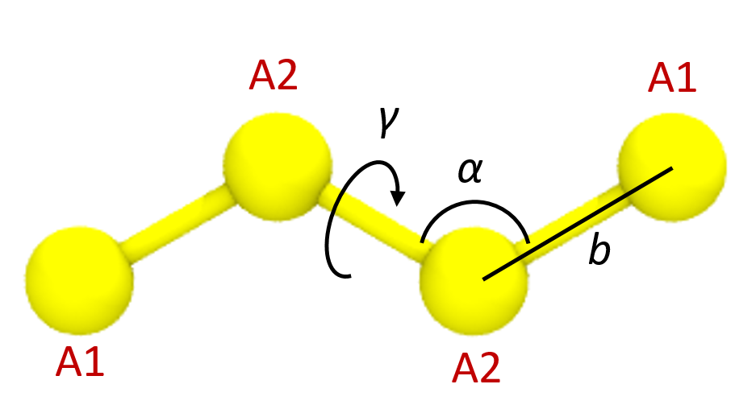
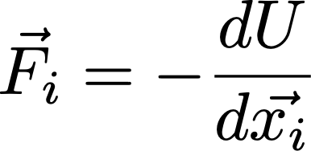
Evaluating interatomic interactions
MD simulation require defining a system topology. This includes information on:
Connectivity between atoms (covalent bond network)
Atom types (depend on chemical environment,
e.g., sp2 or sp3 Carbon)
The functional form of interatomic interactions and their strengths is defined by a force field.

Slide 48
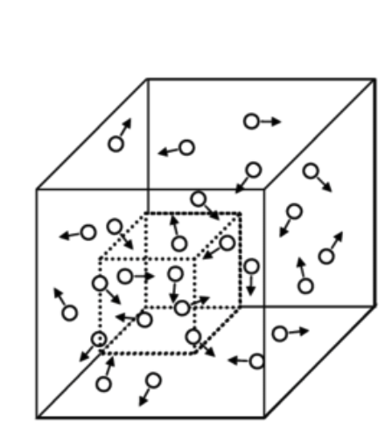
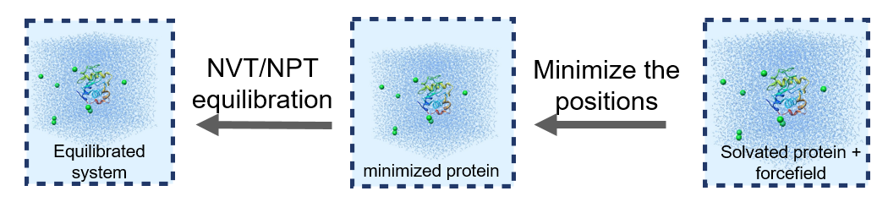
Choosing your thermodynamic ensemble
Simulations replicate a specific thermodynamic ensemble (typically NVT or NPT), or even grand canonical (μVT)
You will have different options to include thermostats (scaling atom velocities) and barostats (scaling positions) in your calculations:
Nose-Hoover
Berendsen
Parrinello-Rahman
Langevin piston
…
μVT

Slide 49

Periodic boundary conditions (PBC)
and pressure coupling
Useful to reduce finite-size effect and simulate bulk
…
…
For membrane systems, use semi-isotropic pressure coupling (x, y ≠ z, lipids compressibility is direction-dependent)
Typically, PBC applied in x, y and z direction

Slide 50
A Molecular Dynamics timestep
Set initial conditions for x, v and box size
Compute forces
Compute new x and v for all atoms
Apply restraints to bonds
Scale x and v with thermo/barostat
Update x and v (with boundary conditions)

Slide 51

Molecular dynamics require multiple steps for the setup of simulations
http://www.bevanlab.biochem.vt.edu/Pages/Personal/justin/gmx-tutorials/lysozyme/01_pdb2gmx.html
Levitt, Nature Struct. Biol., 2001

Slide 52
Simulation of Biomolecules
Basic Simulation
Analysis
Delivered by Tim Spankie
University of Edinburgh
January 2025
Based on content from a ten-hour series https://github.com/CCPBioSim/BioSim-analysis-workshop
by Matteo Degiacomi (matteo.degiacomi@ed.ac.uk) and Antonia Mey (antonia.mey@ed.ac.uk)

Slide 53

Volume and pressure equilibration
Steps until production:
Production ensemble
Minimisation
Living J.Comp.Mol.Sci. 2019,1,5957

Slide 54

[Recall] Sampling the conformational space
$$p_{i}∝ e^{{−ε_{i}}/{kT}}$$
Probability of sampling a conformation is inversely proportional to its energy:

Slide 55

Timescales in biology
Different regions, different timescales:
Side chains faster than backbone
Loops faster than helices and sheets
backbone faster than side chains
Protein surface faster than core
MD

Slide 56


Root Mean Square Deviation (RMSD)
Given a system with N atoms, and a reference arrangement $x_{0}:$
$$RMSD=\sqrt{\frac{1}{N}\sum_{i=0}^{N}{{\left(X_{i}−x_{0}\right)}^{2}}}$$
In MD, $x_{0}$ is often the first conformation in the simulation.
HIV-1 capsomer simulation from: Degiacomi & Dal Peraro, Structure, 2013

Slide 57


Convergence?
Refrain from using RMSD as a single indicator of simulation convergence.
HIV-1 capsomer simulation from: Degiacomi & Dal Peraro, Structure, 2013

Slide 58

RMSD is alignment- and selection-dependent

Slide 59

Pairwise RMSD
Two structures with same RMSD from a reference are not forcefully similar to each other.
Pairwise RMSD helps seeing if protein re-visits conformations throughout the simulation.

Slide 60


Root Mean Square Fluctuation (RMSF)
The RMSF $σ_{i}$of atom i calculates how much it fluctuates around its mean position $\left\langle X_{i}\right\rangle$.
$$σ_{i}=\sqrt{\left\langle {\left(X_{i}−\left\langle X_{i}\right\rangle \right)}^{2}\right\rangle }$$
i
Helps identifying flexible/regid regions.
Typically done on $C_{α}$ atoms.
Warning: result depends on alignment!

Slide 61

end-to-end distance and Radius of Gyration (Rg)
$$d(p,q)=\left\|p−q\right\|$$
$$R_{g}=\sqrt{\frac{1}{N}{\left|r_{k}−r_{mean}\right|}^{2}}$$
q = C-ter
p = N-ter
Help quantifying protein compaction.
Internal properties: do not depend on alignment

Slide 62
Simulation of Biomolecules
Dimensionality
Reduction
Delivered by Tim Spankie
University of Edinburgh
January 2025
Based on content from a ten-hour series https://github.com/CCPBioSim/BioSim-analysis-workshop
by Matteo Degiacomi (matteo.degiacomi@ed.ac.uk) and Antonia Mey (antonia.mey@ed.ac.uk)

Slide 63




features are possible ways to represent data
φ
ψ
Sphericity (1)
Pixels colour
(28x28 = 784)
atomic positions (459)
atomic distances (3)
Torsional angles (2)

Slide 64

Not all features are useful
Task: predict the weather in Edinburgh
using historical data
data = {X, Y, Z} → sun, rain, snow
{Temperature (C),
Temperature (K),
Humidity (g/m³)}
{Temperature (C),
Swiss cheese export (£),
Humidity (g/m³)}
{Avg. gas expenditure (£),
Heat strokes (#),
Slipping accidents (#),
Sunscreen sold (£)}
2 decorrelated features
2 relevant features
4 features connected to another quantity: temperature

Slide 65



Curse of dimensionality
$${\left\|x\right\|}_{2}=\sqrt{\sum_{i=1}^{N}{x_{i}^{2}}}$$
Distances between M data points $x∈{\text{ℝ}}^{N}$increase, when N increases
Problem: less data density increases uncertainty on underlying data structure
Notes:
Dimensions of features
Statistical distribution
Euclidean distance (L2 norm)

Slide 66




[Extra] Curse of dimensionality
Distribution of pairwise
distances between points
shown in previous slide
$${\left\|x\right\|}_{2}=\sqrt{\sum_{i=1}^{N}{x_{i}^{2}}}$$
Distances between M data points $x∈{\text{ℝ}}^{N}$increase, when N increases
Problem: less data density increases uncertainty on underlying data structure

Slide 67
Reducing features increases data density
Chose appropriate features [expert user]
Remove features
Find a lower dimensional representation E of features X
{ X₁ , X₂ , … , X_{N} }
{ E₁ , E₂ , … , E_{K} }
E_{i} = f({X})
where K < N

Slide 68

Principal Components Analysis (PCA)
Let X a dataset of M datapoints in N dimensions (here, M=50 and N=2)
Center data:
X’ = X - $µ$
Compute data covariance matrix C:
$c_{i,j}=\frac{1}{M}\sum_{k=1}^{M}{{x′}_{i}{x′}_{j}}$
Calculate eigenvalue decomposition:
$$C=VλV^{−1}$$
NxN matrix of eigenvectors
NxN diagonal matrix of eigenvalues
Notes:
Recall: all vectors are rotated by covariance matrix, but those in the direction of maximal data spread. Those are only scaled.

Slide 69
[Extra] Principal Components Analysis (PCA)
Let X a dataset of M datapoints in N dimensions (here, M=50 and N=2)
An eigenvector $v$ of $C$respects:
$$Cv=λv$$
Find eigenvalues as the roots of the characteristic polynomial:
$$p\left(λ\right)=det(C−λI)=0$$
The i-th eigenvector $v_{i}$is found by solving:
$Cv_{i}=$ $λ_{i}v_{i}$
Notes:
Recall: all vectors are rotated by covariance matrix, but those in the direction of maximal data spread. Those are only scaled.

Slide 70

Principal Components Analysis (PCA)
Let X a dataset of M datapoints in N dimensions (here, M=50 and N=2)
$$C=VλV^{−1}$$
$V=[v_{1}…v_{N}]$ eigenvectors: orthonormal base
$λ$ eigenvalues: scalars defining the importance of each eigenvector
Importance $r_{i}$of each eigenvector $v_{i}$:
$$r_{i}=\frac{λ_{i}}{\sum{λ}}$$
Sort $V$ and $λ$ according to $λ$
Notes:
TALK ABOUT HOW EIGENVALUES TELL YOU HOW IMPORTANT AN EIGENVECTOR IS!
(link it to length of arrows in the plot)
Add worked example using data we have here?

Slide 71


Projection into the eigenspace
Let X a dataset of M datapoints in N dimensions (here, M=50 and N=2)
$$p={V^{T}\left(x −µ\right)}^{}$$
transform
Notes:
CHECK EQUATION!
Feature ablation: remove features with least variance x’ = (x – mu)Tei, for I in 1..M

Slide 72




Dimensionality reduction
Remove dimensions that least contribute to data variance
$$p={V^{T}\left(x −µ\right)}^{}$$
transform

Slide 73


[Example 2] Identifying dominant motions in proteins
Protein MD simulation
Eigenspace of C_{α} coordinates
Simulations are complex and noisy
The first PCs capture large-scale collective motions, last ones capture noise
Degiacomi, M.T. & Dal Peraro, M.. Macromolecular symmetric assembly prediction using swarm intelligence dynamic modeling. Structure, 2013

Slide 74
largest-scale motion ≠ slowest motion
Thought experiment reminder: typically hydrogen bond is considered established if donor-acceptor distance <2.5 Å, and donor-acceptor-hydrogen angle <20°.
bond
formed
50%
bond not
formed
50%
time
time
Biological function is often determined by the kinetics of a process (e.g., a specific conformational change).
Two processes with different kinetics can have the same statistical distribution in terms of structure.
PCA separates in terms of structure, not timescales!

